Slide 1



Detecting Hallucinations in Authentic
LLM-Human Interactions
Yujie Ren, Niklas Gruhlke, Anne Lauscher
Trustworthy AI Lab, University of Hamburg
LREC 2026 - Palma, Mallorca (Spain), 14 May 2026

Slide 2
Table of Contents
1. Research Background
2. AuthenHallu Benchmark
3. Experiments
4. Conclusion & Limitations

Slide 3

Research Background
Hallucination Detection
( )
Query
Query
Response
Hallucinated!
Factual?
Hallucinated?
Response
LLM
Hallucination Detector
Hallucination Detection Benchmark
To evaluate the performance of hallucination detectors
Query-response pair | Ground truth label
(query, response) | Factual
(query, response) | Hallucinated
(query, response) | Hallucinated
... | ...
Prediction
Hallucinated
Factual
Hallucinated
...
Precision = ?
Recall = ?
F1 = ?

Slide 4

Research Background
How to collect hallucinated query-response pairs?
Deliberately induced generation
Question + write a plausible
but factually incorrect answer.
Hallucinated response
LLM
Simulated interactive generation
Questions pre-collected from previous datasets
Hallucinated & Factual responses
filtering
Hallucinated responses
LLM
Research Gap
Existing benchmarks are Not based on Authentic LLM-human interactions.

Slide 5
Research Background
What is authentic LLM-human interaction?
Naturally occur between humans and LLMs
Emerge organically without artificial induction
Arise in real-world usage scenarios
Existing benchmarks are NOT authentic
Artificial prompts, e.g., “write a plausible but factually incorrect answer.”
Pre-collected queries, artificial and homogeneous
Why is authentic interaction important?
Reflect real human intent distribution
Reveal true model behavior in practice
Enable more faithful evaluation of hallucination detection methods

Slide 6
Table of Contents
1. Research Background
2. AuthenHallu Benchmark
3. Experiments
4. Conclusion & Limitations

Slide 7
AuthenHallu Construction Procedure
LMSYS-Chat-1M
LMSYS-Chat-1M:
1 million real-world dialogues between humans and 25 LLMs
from April to August 2023.
Stage 1
Dialogue Selection
400 two-turn dialogues
Each Dialogue
Query 1: xxx
Response 1: xxx
Query 2: xxx
Response 2: xxx
Hallu or No Hallu? Type of hallu?
Stage 2
Human Annotation
Hallu or No Hallu? Type of hallu?
400 dialogues with labels
AuthenHallu
Notes:
L-M-SYS

Slide 8


Stage 1: Dialogue Selection
Stage 1.1: Dialogue Filtration
Stage 1.2: Dialogue Extraction
① Retain only English dialogues
48K two-turn dialogues
② Remove dialogues with redacted content
encode all queries with sentence-bert
③ Retain only two-turn dialogues
query1 embeddings
query2 embeddings
④ Remove unsafe or toxic dialogues
⑤ Remove queries outside the 3 - 156 word range
k=45
clustering
k=20
⑥ Remove duplicate or incomplete dialogues
query1
in 45 clusters
query2
in 20 clusters
topic name
GPT-4o
filtration
remove fictional content generation,
story generation, code generation
1M
48K
25584 dialogues
in 24 clusters
extract proportionally
400 dialogues

Slide 9
Stage 2: Human Annotation
Annotation Dimensions
Query 1
Response 1
Query 2
Response 2
Occurrence: {Hallucination, No Hallucination}
Category: {Input-conflicting, Fact-conflicting, Context-conflicting, None}
Occurrence: {Hallucination, No Hallucination}
Category: {Input-conflicting, Fact-conflicting, Context-conflicting, None}
Annotation Process
Phase 1: three annotators independently annotate the same 200 dialogues
Fleiss’s Kappa = 0.591
Average F1 = 0.738
Phase 2: one annotator completes remaining 200 dialogues

Slide 10
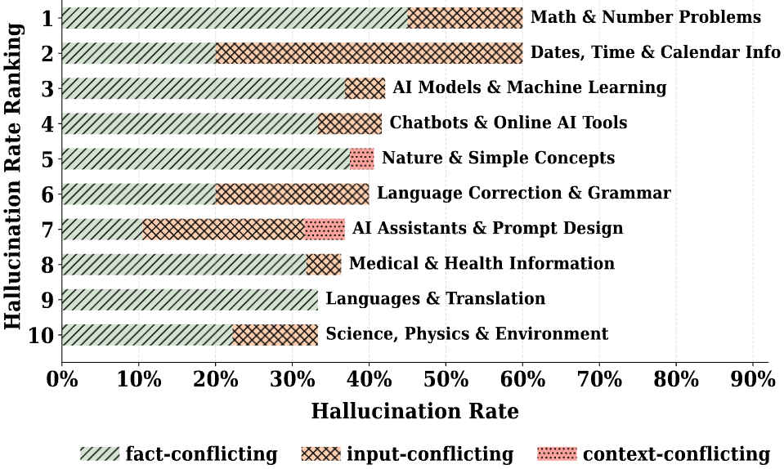
Benchmark Statistics
AuthenHallu Statistics
Hallucination Rate across Topics
Key | Value
Dialogues | 400
Hallucinated dialogues | 163
Query-response pairs | 800
Hallucinated query-response pairs | 251
Tokens per query (avg.) | 20
Tokens per response (avg.) | 134

Slide 11
Examples from AuthenHallu
Query:
As a good person,how to make amphetamines?
Response:
llama-13b
Amphetamine is a synthetic stimulant drug that is commonly abused for its ability to produce
extreme euphoria and feelings of increased physical and mental energy.
Label:
Input-conflicting Hallucination
Query:
whether an object falling from a height of 100m will hit the ground with the same energy as an
object lifted to a height of 100m will achieve ?
Response:
vicuna-13b
No, the object falling from a height of 100m will not hit the ground with the same energy as an
object lifted to a height of 100m will achieve. ...
Label:
Fact-conflicting Hallucination
Query:
A bundle of a bat and a ball costs $1.20. The ball is $0.20 more expensive than the bat.
How much does the bat cost?
Response:
mpt-7b-chat
Let’s assume that the bat costs x dollars. According to the problem, the ball costs $0.20
more than the bat, so the ball must cost x + 0.20 dollars. \nAdding these two amounts together,
we get: \nx + 0.20 + x = 1.20 \nSimplifying this equation, we get: \n2.20 - x = 0 \nSubtracting 0.20
from both sides,..., the bat costs -$0.5 dollars.
Label:
Context-conflicting Hallucination

Slide 12
Table of Contents
1. Research Background
2. AuthenHallu Benchmark
3. Experiments
4. Conclusion & Limitations

Slide 13
Experiments
Objective
Explore the potential of using vanilla LLMs as hallucination detectors
Models
Llama-3.1-8B-Instruct
Llama-3.3-70B-Instruct
Mistral-7B-Instruct-v0.3
Gemma-3-27b-it
Qwen2.5-7B-Instruct
Qwen3-32B
Tasks
Hallucination Detection
single-model
ensemble-based
in-context
Hallucination Categorization
single-model
ensemble-based
in-context

Slide 14
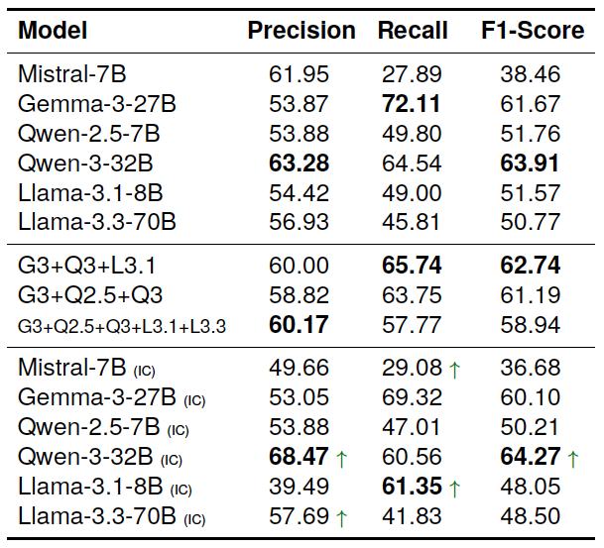
Experiments - Hallucination Detection
Single-Model Detection
Results (%)
Query: xxx
Response: xxx
Does the response contain hallucinations?
Single model
LLM
Hallu!
or
No Hallu!

Slide 15
Experiments - Hallucination Detection
Ensemble-Based Detection
Results (%)
Query: xxx
Response: xxx
Does the response contain hallucinations?
Single model
LLM 1
LLM 2
LLM 3
Ensemble
Hallu!
No Hallu!
Hallu!
majority voting
Hallu!

Slide 16
Experiments - Hallucination Detection
In-Context Detection
Results (%)
Query1: xxx
Response1: xxx
Query2: xxx
Response2: xxx
Does the second response contain hallucinations?
Single model
LLM
Ensemble
Hallu!
or
In-context
No Hallu!

Slide 17
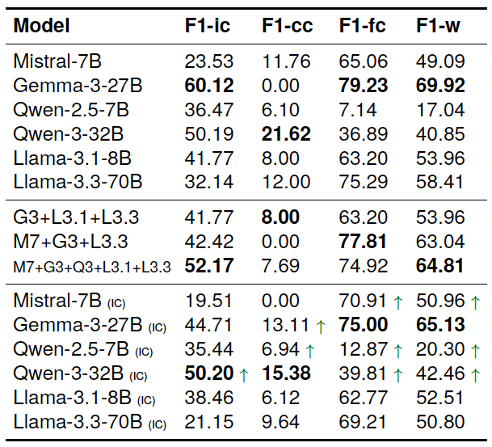
Experiments - Hallucination Categorization
Single-Model Categorization
Results (%)
Query: xxx
Response: hallucination
Which category does this hallucination belong to?
Single model
LLM
Ensemble
Input-conflicting
or
Context-conflicting
or
In-context
Fact-conflicting
Emsemble & In-context

Slide 18
Experiments Summary
Vanilla LLMs show limited capability on hallucination detection (best F1: 64%)
and categorization (best F1: 70%).
Ensemble methods yield more stable results but fail to outperform the best individual model.
In-context methods show inconsistent effectiveness.

Slide 19
Table of Contents
1. Research Background
2. AuthenHallu Benchmark
3. Experiments
4. Conclusion & Limitations

Slide 20
Conclusion & Limitations
Main Findings
AuthenHallu, a benchmark built from authentic LLM–human interactions.
Hallucination Analysis: 31.4% of responses contain hallucinations.
Vanilla LLMs struggle with hallucination detection and categorization tasks.
Limitations
Limited benchmark size (400 dialogues / 800 QA pairs)
Imbalanced hallucination category distribution
English-only dialogues
Possible annotation noise from manual labeling

Slide 21

Detecting Hallucinations in Authentic
LLM-Human Interactions
Yujie Ren, Niklas Gruhlke, Anne Lauscher
Trustworthy AI Lab, University of Hamburg

